Slide 1

Software Architecture
SSE USTC Qing Ding
dingqing@ustc.edu.cn
http://staff.ustc.edu.cn/~dingqing

Slide 2

Quality Attributes of Architecture I
Availability

Slide 3
Agenda
Quality Attributes of Architecture
Availability
  Source of stimulus
  Stimulus
  Environment
  Artifact
  Response
  Response measure
  Tactics

Slide 4
Why do we should consider QA?
Business considerations determine qualities that must be accommodated in a system's architecture.
  These qualities are over and above that of functionality, which is the basic statement of the system's capabilities, services, and behavior
Systems are frequently redesigned not because they are functionally deficient,
  but because they are difficult to maintain, port, or scale, or are too slow, or have been compromised by network hackers.
  the replacements are often functionally identical

Slide 5
Functionality and Architecture
Functionality and quality attributes are orthogonal
  this is not to say that any level of any quality attribute is achievable with any function.
  any of functions your choices as an architect will determine the relative level of quality
What is functionality?
  It is the ability of the system to do the work for which it was intended.
Functionality may be achieved through the use of any of a number of possible structures.

Slide 6
Architecture and Quality Attributes
Achieving quality attributes must be considered throughout design, implementation, and deployment.
  No quality attribute is entirely dependent on design, nor is it entirely dependent on implementation or deployment.
Satisfactory results are a matter of getting the big picture (architecture) as well as the details (implementation) correct. For example:
  Usability
  Modifiability
  Performance

Slide 7
Architecture and Quality Attributes
The message of this section is twofold:
  Architecture is critical to the realization of many qualities of interest in a system, and these qualities should be designed in and can be evaluated at the architectural level.
  Architecture, by itself, is unable to achieve qualities. It provides the foundation for achieving quality, but this foundation will be to no avail if attention is not paid to the details.

Slide 8
Architecture and Quality Attributes
Within complex systems, quality attributes can never be achieved in isolation. The achievement of any one will have an effect, sometimes positive and sometimes negative, on the achievement of others.
  security and reliability
  almost every quality attribute negatively affects performance
We will examine the following three classes:
  Qualities of the system. We will focus on availability, modifiability, performance, security, testability, and usability.
  Business qualities (such as time to market) that are affected by the architecture.
  Architecture qualities, such as conceptual integrity, that are about the architecture itself although they indirectly affect other qualities, such as modifiability.

Slide 9
Quality Attribute Scenarios
A quality attribute scenario is a quality-­‐‑attribute-­‐‑specific requirement. It consists of six parts.
  Source of stimulus. This is some entity (a human, a computer system, or any other actuator) that generated the stimulus.
  Stimulus. The stimulus is a condition that needs to be considered when it arrives at a system.
  Environment. The stimulus occurs within certain conditions. The system may be in an overload condition or may be running when the stimulus occurs, or some other condition may be true.
  Artifact. Some artifact is stimulated. This may be the whole system or some pieces of it.
  Response. The response is the activity undertaken after the arrival of the stimulus.
  Response measure. When the response occurs, it should be measurable in some fashion so that the requirement can be tested.

Slide 10
AVAILABILITY
Availability is concerned with system failure and its associated consequences.
  system failure occurs when the system no longer delivers a service consistent with its specification. Such a failure is observable by the system's users—either humans or other systems.
Among the areas of concern are
  how system failure is detected
  how frequently system failure may occur
  what happens when a failure occurs
  how long a system is allowed to be out of operation
  when failures may occur safely
  how failures can be prevented
  what kinds of notifications are required when a failure occurs

Slide 11
AVAILABILITY
We need to differentiate between failures and faults.
  A fault may become a failure if not corrected or masked. That is, a failure is observable by the system's user and a fault is not. When a fault does become observable, it becomes a failure.
  For example, a fault can be choosing the wrong algorithm for a computation, resulting in a miscalculation that causes the system to fail.
Once a system fails, an important related concept becomes the time it takes to repair it.
  Since a system failure is observable by users, the time to repair is the time until the failure is no longer observable.
10

Slide 12
AVAILABILITY
The distinction between faults and failures allows discussion of automatic repair strategies.
– That is, if code containing a fault is executed but the system is able to recover from the fault without it being observable, there is no failure.
11

Slide 13
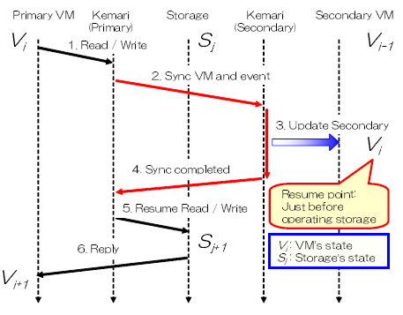
AVAILABILITY
For example：
Kemari
http://www.osrg.net/kemari/
Kemari: Virtual Machine Synchronization for Fault Tolerance
http://wiki.xensource.com/xenwiki/O pen_Topics_For_Discussion?action=Atta chFile&do=get&target=Kemari_08.pdf

Slide 14
AVAILABILITY
Source of stimulus.
  We differentiate between internal and external indications of faults or failure since the desired system response may be different.
Stimulus. A fault of one of the following classes occurs.
  omission. A component fails to respond to an input.
  crash. The component repeatedly suffers omission faults.
  timing. A component responds but the response is early or late.
  response. A component responds with an incorrect value.
Artifact.
  This specifies the resource that is required to be highly available, such as a processor, communication channel, process, or storage.
Environment.
  The state of the system when the fault or failure occurs may also affect the desired system response. For example, if the system has already seen some faults and is operating in other than normal mode, it may be desirable to shut it down totally. However, if this is the first fault observed, some degradation of response time or function may be preferred.

Slide 15
AVAILABILITY
Response.
  There are a number of possible reactions to a system failure. These include
    logging the failure
    notifying selected users or other systems
    switching to a degraded mode with either less capacity or less function
    shutting down external systems
    becoming unavailable during repair.
Response measure.
  The response measure can specify an availability percentage, or it can specify a time to repair, times during which the system must be available, or the duration for which the system must be available.

Slide 16
AVAILABILITY
Portion of Scenario Source
Stimulus Artifact
Possible Values
Internal to the system; external to the system Fault: omission, crash, timing, response
System's processors, communication channels, persistent storage, processes
Normal operation;
degraded mode (i.e., fewer features, a fall back solution)
System should detect event and do one or more of the following:
record it
notify appropriate parties, including the user and other systems
disable sources of events that cause fault or failure according to defined rules
be unavailable for a pre-specified interval, where interval depends on criticality of system
continue to operate in normal or degraded mode
Time interval when the system must be available Availability time
Time interval in which system can be in degraded mode
Repair time
Environment
Response
Response Measure

Slide 17
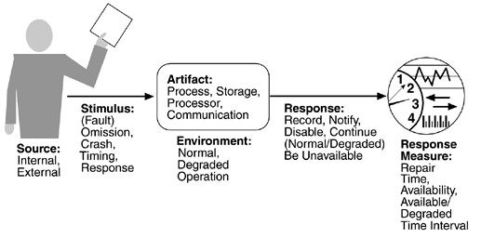
AVAILABILITY

Slide 18
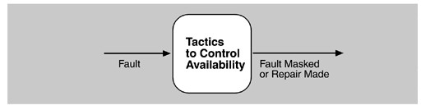
Availability Tactics
A failure occurs when the system no longer delivers a service that is consistent with its specification; this failure is observable by the system's users.
A fault (or combination of faults) has the potential to cause a failure.
Recovery or repair is an important aspect of availability.
The tactics we discuss in this section will keep faults from becoming failures or at least bound the effects of the fault and make repair possible.
Goal of availability tactics

Slide 19
Availability Tactics
Many of the tactics we discuss are available within standard execution environments such as operating systems, application servers, and database management systems.
It is still important to understand the tactics used so that the effects of using a particular one can be considered during design and evaluation.
All approaches to maintaining availability involve some type of redundancy, some type of health monitoring to detect a failure, and some type of recovery when a failure is detected.
– In some cases, the monitoring or recovery is automatic and in others it is manual.
We first consider fault detection. We then consider fault recovery and finally, briefly, fault prevention.

Slide 20
Availability Tactics-­fault detection
Three widely used tactics for recognizing faults are ping/echo, heartbeat, and exceptions.
  Ping/echo.
    One component issues a ping and expects to receive back an echo, within a predefined time, from the component under scrutiny.
    This can be used within a group of components mutually responsible for one task.
    It can also used be used by clients to ensure that a server object and the communication path to the server are operating within the expected performance bounds.
    "Ping/echo" fault detectors can be organized in a hierarchy, in which a lowest-­‐‑level detector pings the software processes with which it shares a processor, and the higher-­‐‑level fault detectors pinglower-­‐‑ level ones.
    This uses less communications bandwidth than a remote fault detector that pings all processes.

Slide 21
Availability Tactics-­fault detection
Heartbeat (dead man timer).
  In this case one component emits a heartbeat message periodically and another component listens for it.
  If the heartbeat fails, the originating component is assumed to have failed and a fault correction component is notified.
  The heartbeat can also carry data. For example, an automated teller machine can periodically send the log of the last transaction to a server. This message not only acts as a heartbeat but also carries data to be processed.

Slide 22
Availability Tactics-­fault detection
Exceptions.
  One method for recognizing faults is to encounter an exception, which is raised when one of the fault classes is recognized.
  The exception handler typically executes in the same process that introduced the exception.
The ping/echo and heartbeat tactics operate among distinct processes, and the exception tactic operates within a single process.
The exception handler will usually perform a semantic transformation of the fault into a form that can be processed.

Slide 23
Availability Tactics-­fault detection
Suppose we want to add fault detection of DBMS into SNS in order to detect the connectivity error of DBMS
  Now that the workload of DB server is high, the influence of added fault detection on performance shall be as light as possible.
  Meanwhile, since connectivity error is a serious error, we hope we can detect it as soon as possible.
Consequently, heartbeat is chosen as the tactic for fault detection.
  To add a service in the system which creates connection to DBMS periodically and sends the result of operation to other components.

Slide 24
Availability Tactics-­fault detection
In an embedded safety-­‐‑critical system: aircraft
Self check
  Power-­‐‑on self check
  Periodical self check
  Manual self check
  Command triggered self check
  To display the error code with LED

Slide 25
Availability Tactics-­fault recovery
Fault recovery consists of preparing for recovery and making the system repair. Some preparation and repair tactics follow.
Active redundancy (hot restart).
  All redundant components respond to events in parallel. Consequently, they are all in the same state.
  The response from only one component is used (usually the first to respond), and the rest are discarded.
  When a fault occurs, the downtime of systems using this tactic is usually milliseconds since the backup is current and the only time to recover is the switching time.
  Active redundancy is often used in a client/server configuration, such as database management systems, where quick responses are necessary even when a fault occurs. In a highly available distributed system, the redundancy may be in the communication paths. For example, it may be desirable to use a LAN with a number of parallel paths and place each redundant component in a separate path. In this case, a single bridge or path failure will not make all of the system's components unavailable.

Slide 26
Availability Tactics-­fault recovery
Synchronization is performed by ensuring that all messages to any redundant component are sent to all redundant components.
If communication has a possibility of being lost (because of noisy or overloaded communication lines), a reliable transmission protocol can be used to recover.
A reliable transmission protocol requires all recipients to acknowledge receipt together with some integrity indication such as a checksum.
If the sender cannot verify that all recipients have received the message, it will resend the message to those components not acknowledging receipt.
The resending of unreceived messages (possibly over different communication paths) continues until the sender marks the recipient as out of service.

Slide 27
Availability Tactics-­fault recovery
Passive redundancy (warm restart/dual redundancy/triple redundancy).
  One component (the primary) responds to events and informs the other components (the standbys) of state updates they must make. When a fault occurs, the system must first ensure that the backup state is sufficiently fresh before resuming services.
  This approach is also used in control systems, often when the inputs come over communication channels or from sensors and have to be switched from the primary to the backup on failure.
  Describing an air traffic control example, shows a system using it. In the air traffic control system, the secondary decides when to take over from the primary, but in other systems this decision can be done in other components.

Slide 28
Availability Tactics-­fault recovery
This tactic depends on the standby components taking over reliably. Forcing switchovers periodically—for example, once a day or once a week—increases the availability of the system.
Some database systems force a switch with storage of every new data item. The new data item is stored in a shadow page and the old page becomes a backup for recovery. In this case, the downtime can usually be limited to seconds.
Synchronization is the responsibility of the primary component, which may use atomic broadcasts to the secondaries to guarantee synchronization.

Slide 29
Availability Tactics-­fault recovery
Spare.
  A standby spare computing platform is configured to replace many different failed components.
  It must be rebooted to the appropriate software configuration and have its state initialized when a failure occurs.
  Making a checkpoint of the system state to a persistent device periodically and logging all state changes to a persistent device allows for the spare to be set to the appropriate state.
  This is often used as the standby client workstation, where the user can move when a failure occurs.
  The downtime for this tactic is usually minutes.

Slide 30
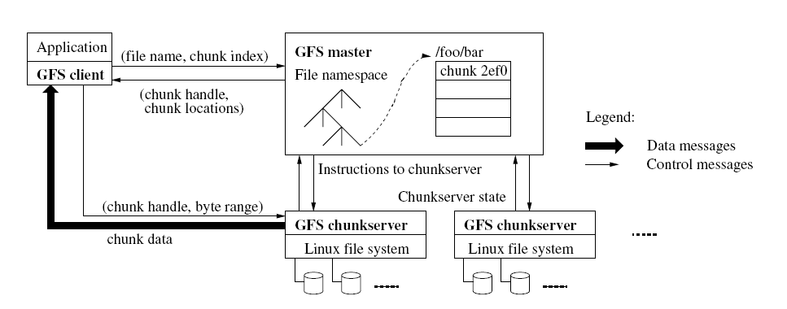
Availability Tactics-­fault recovery
GFS

Slide 31
Availability Tactics-­fault recovery
Suppose we want to add backup mechanism to the DB in order to replace main server with backup server when the former has some faults.
  Now that SNS is not a critical system, its availability is not necessary to be very high, we allow some sessions of clients to be lost.
  Meanwhile, once a user generates new data, it should be persistently stored into DB
Consequently, we use passive redundancy as the backup mechanism of SNS
29

Slide 32
Availability Tactics-­fault recovery
In an embedded safety-­‐‑critical system: aircraft
Redundancy
  Storage
  Binary code
  Communication linkage
30

Slide 33
Availability Tactics-­fault repair
There are tactics for repair that rely on component reintroduction.
  When a redundant component fails, it may be reintroduced after it has been corrected. Such tactics are shadow operation, state resynchronization, and rollback.
Shadow operation.
  A previously failed component may be run in "shadow mode" for a short time to make sure that it mimics the behavior of the working components before restoring it to service.
Checkpoint/rollback.
  A checkpoint is a recording of a consistent state created either periodically or in response to specific events.
  Sometimes a system fails in an unusual manner, with a detectably inconsistent state. In this case, the system should be restored using a previous checkpoint of a consistent state and a log of the transactions that occurred since the snapshot was taken.

Slide 34
Availability Tactics-­fault repair
For SNS,
  we adopt checkpoints to do fault repair in order to keep the performance of system.
For instruments of aircraft
  Watchdog
  Software interrupts
  Pluggable components

Slide 35
Availability Tactics-­fault prevention
The following are some fault prevention tactics.
Removal from service.
  This tactic removes a component of the system from operation to undergo some activities to prevent anticipated failures.
  One example is rebooting a component to prevent memory leaks from causing a failure.
  If this removal from service is automatic, an architectural strategy can be designed to support it. If it is manual, the system must be designed to support it.
Transactions.
  A transaction is the bundling of several sequential steps such that the entire bundle can be undone at once.
  Transactions are used to prevent any data from being affected if one step in a process fails and also to prevent collisions among several simultaneous threads accessing the same data.
Process monitor.
  Once a fault in a process has been detected, a monitoring process can delete the nonperforming process and create a new instance of it, initialized to some appropriate state as in the spare tactic.

Slide 36
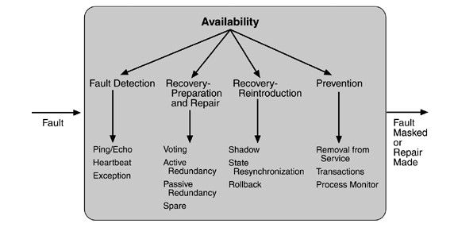
Availability Tactics-­Summary

Slide 37
Project
Suppose you needs to improve the availability of your SNS website. Please describe your design from the following aspects:
  Since your SNS website has a huge number of users, you deployed it into a cluster of multiple servers. Please give the details about how your design detects the failure of servers with heartbeats, includingthe information structure of heartbeat, protocol for heartbeat communication.
  If you want to establish replicas of SNS data, which kind of redundancy do you think is suitable for your SNS website. Please give the detail reason(s).
  What tactics would you want to apply onto your SNS website. Please give the detail reason(s).
35

